Slide 1
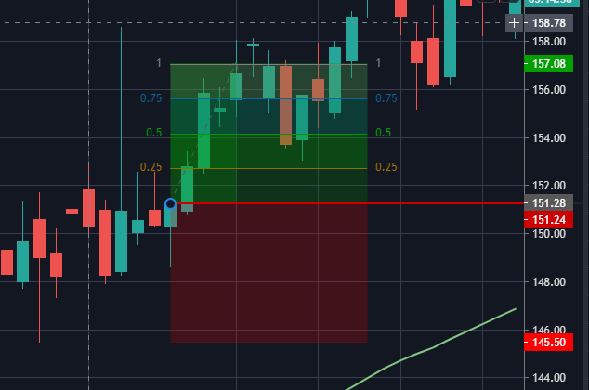
Trailing Stop Loss (TSL)
TSL Step Value;
5.78 / 4 = 1.44
Target Price
= 151.28 + 5.78
= 157.08
Price reaches Target Price
157.08
Close Position
Target Price
= Entry Price + N
= 151.28 + 5.78
Target Price = 157.08
Price reaches 155.60
(154.16 + 1.44)
TSL = 154.16
Price reaches 154.16
(152.72 + 1.44)
TSL = 152.72
Entry Price
= 151.28
= Entry Price – Low 8 bars
= 151.28 – 145.50
= 5.78
Price reaches 152.72
(Entry Price + 1.44)
TSL = Entry Price
TSL at Open 145.50
Recent Low in last 8 bars
= 145.50
Recent Low in last 8 bars

