Slide 1
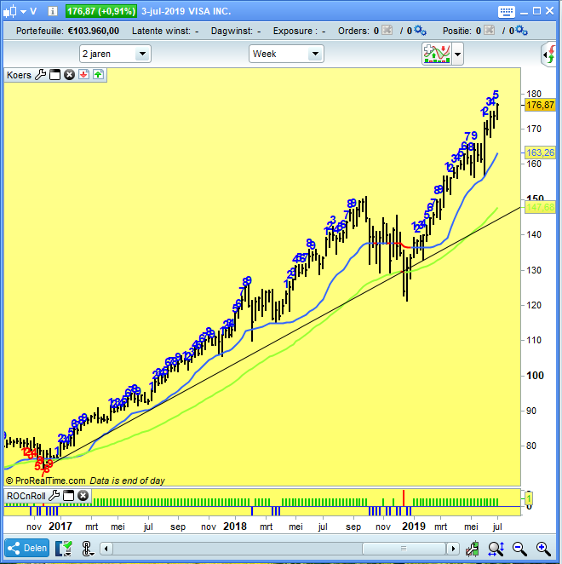
Title: the “GrowthTrendline”-tool
What is it: a simple trendline, but with the slope recalculated as a % growth per year
See Trendline values:
Begin 2017: $ 75
Begin 2018: $ 107
Begin 2019: $ 130
Trading strategy:
“buy stock when is it’s landed on trendline. As long as the stock moves above this trendline, there is at least a yearly growth of 36%. Buy, sit back and let the trendline do it’s work..”
Signal/Alert:
Trendline can be used as:
Alerting by crossing down; no signal means stock is above rising trendline = go up.
Trailing stop loss
Ranking which stocks has the highest GrowthTrendline %;
If the this trendline can be automatically drawn for all charts in a list, we can rank the growth percentages and select the highest growing stock.
$130
$107
Avg growth p.yr: 36%
$75

