Slide 1
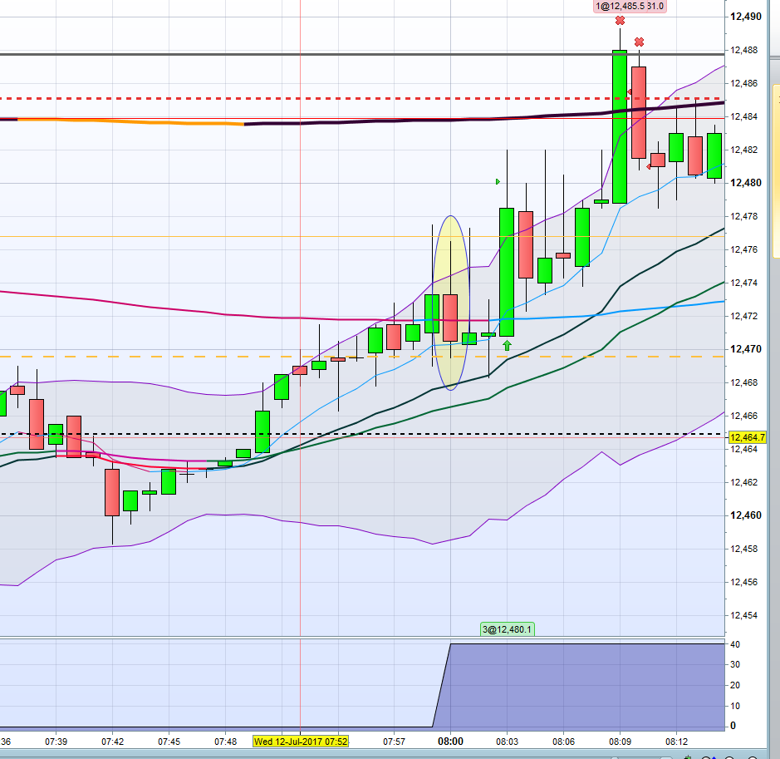
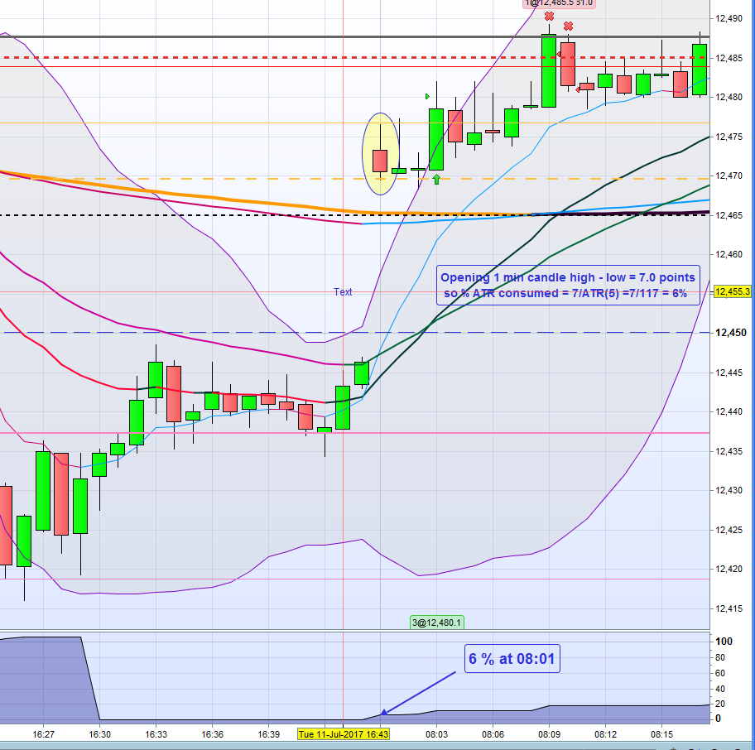
% of ATR filled (08:00-16:30) v2 –problem illustration
The indicator informs us that 6% of the 5 day ATR has been consumed but the problem is that the chart trading times had to be adjusted in the main platform setting to start at 08:00 resulting in lack of overnight data and the price gap
X
The indicator informs us that 40% of the 5 day ATR has already be consumed by price action in the first 1 minute bar from 08:00-08:01. This is wrong, it was a small bar and only 6% of ATR had been consumed

