Slide 1
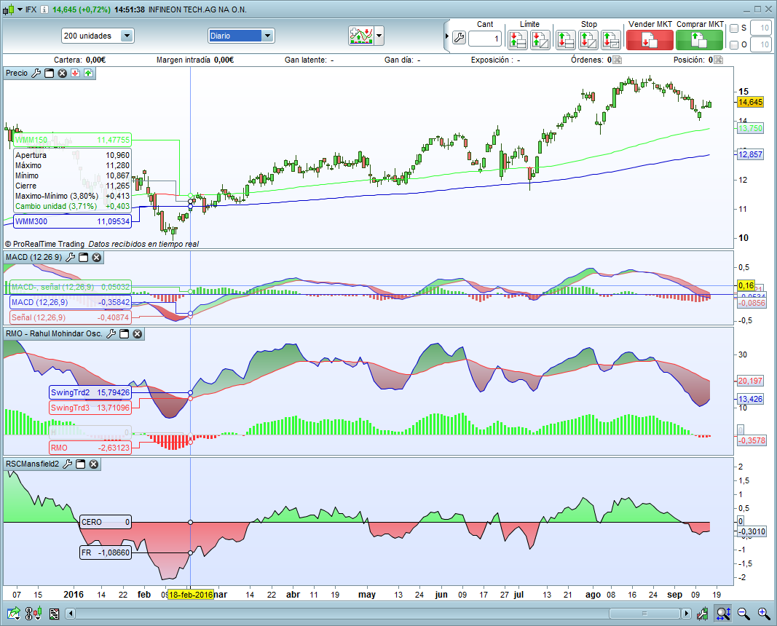
SCREENER RMO

